Slide 1
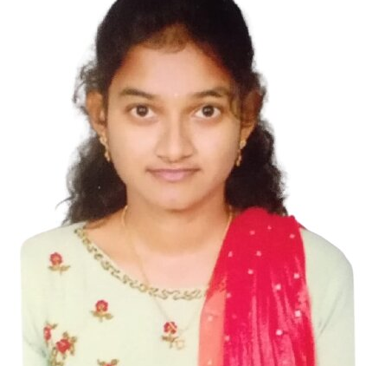

Sowmya, Jakkampudi
Analyst/Software Engineer
B.Tech in Computer Science and Engineering : 2017 - 2021
Skills Java 8
Spring Boot
Spring MVC
JPA CRUD
Bootstrap
Technology Stack
ReactJS
Database
Postgre SQL
Web Technologies
HTML5
CSS3
JavaScript
Add-Ons
Maven
Postman
Additional Details
Leadership
Good Communication Skills
Team management
Bangalore
Jakkampudi.sowmya@capgemini.com
+91 9550546757
A4
Software Engineer who is Strong in design and integration with intuitive problem-solving skills. Passionate about implementing and launching new projects.
Ready to learn new technologies and implement them to further improve my knowledge.
Eager to work in a team of dedicated people and serve a key role in the enhancement and development of the project.
Has working knowledge on ReactJS and Java Microservice Development using Spring framework on an intermediate level.
Also Implemented Nodejs in case study and upskilling day by day.
Online Shopping cart
Completed end to end case study of Online Shopping cart along with Postgre SQL , Stream API , Postman and Spring Security for Authentication. Html, CSS and React Bootstrap used for user interface.

